Slide 1
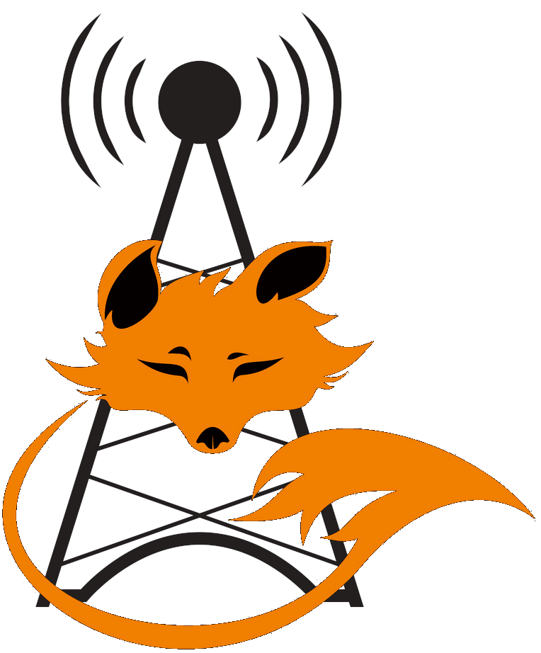
Fox Hunting
Travis Few
N9EOD

Slide 2
What is Fox Hunting
Also known as bunny hunts, Amateur Radio Direction Finding (ARDF), Transmitter Hunting
In fox hunting, participants attempt to find a hidden transmitter, or transmitters, using directional antennas within a designated area
Searches can be done on foot, in a vehicle, or even from your own shack
Some hunts, often organized by local clubs, are just for kicks while others are highly competitive and offer prizes for the most skilled hunters
Competitive fox hunting, ARDF, is most popular in Europe and Asia, and is slowly gaining a nice following of enthusiasts in North America

Slide 3

Styles Of Fox Hunts
Can be a large area with vehicles as the main mode of transport
Smaller areas where low powered transmitters are used in a park
A combo of both
Or used to simulate a scenario such as a lost hiker in an area

Slide 4
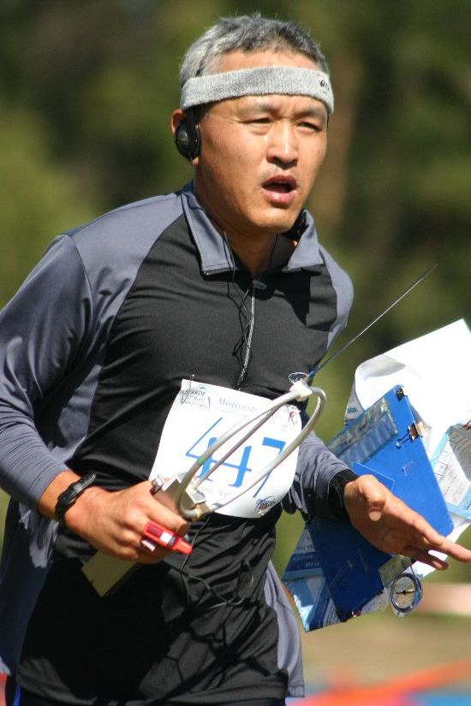
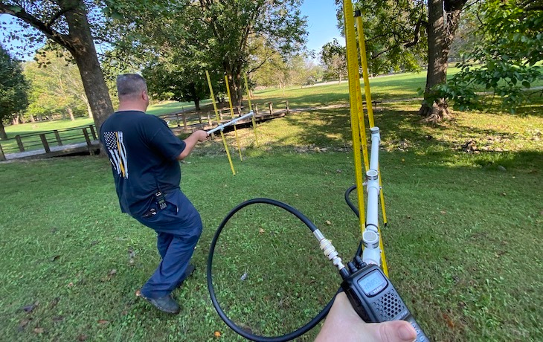
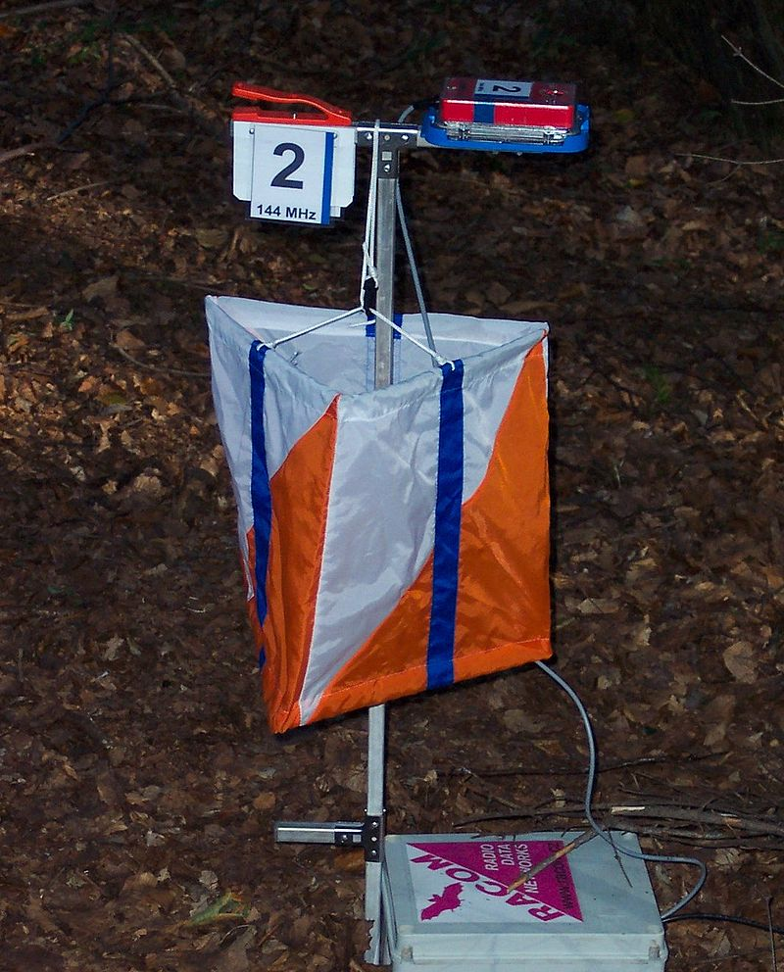

Fox Hunting vs ARDF

Slide 5
Why Do It?
You get out of the shack and moving (Exercise)
Friendly competition
Anyone can take part - you don’t need a ham license since only a receiver is required
The social aspect of getting together with others with similar interests
The satisfaction of building your own equipment such as an antenna or fox

Slide 6
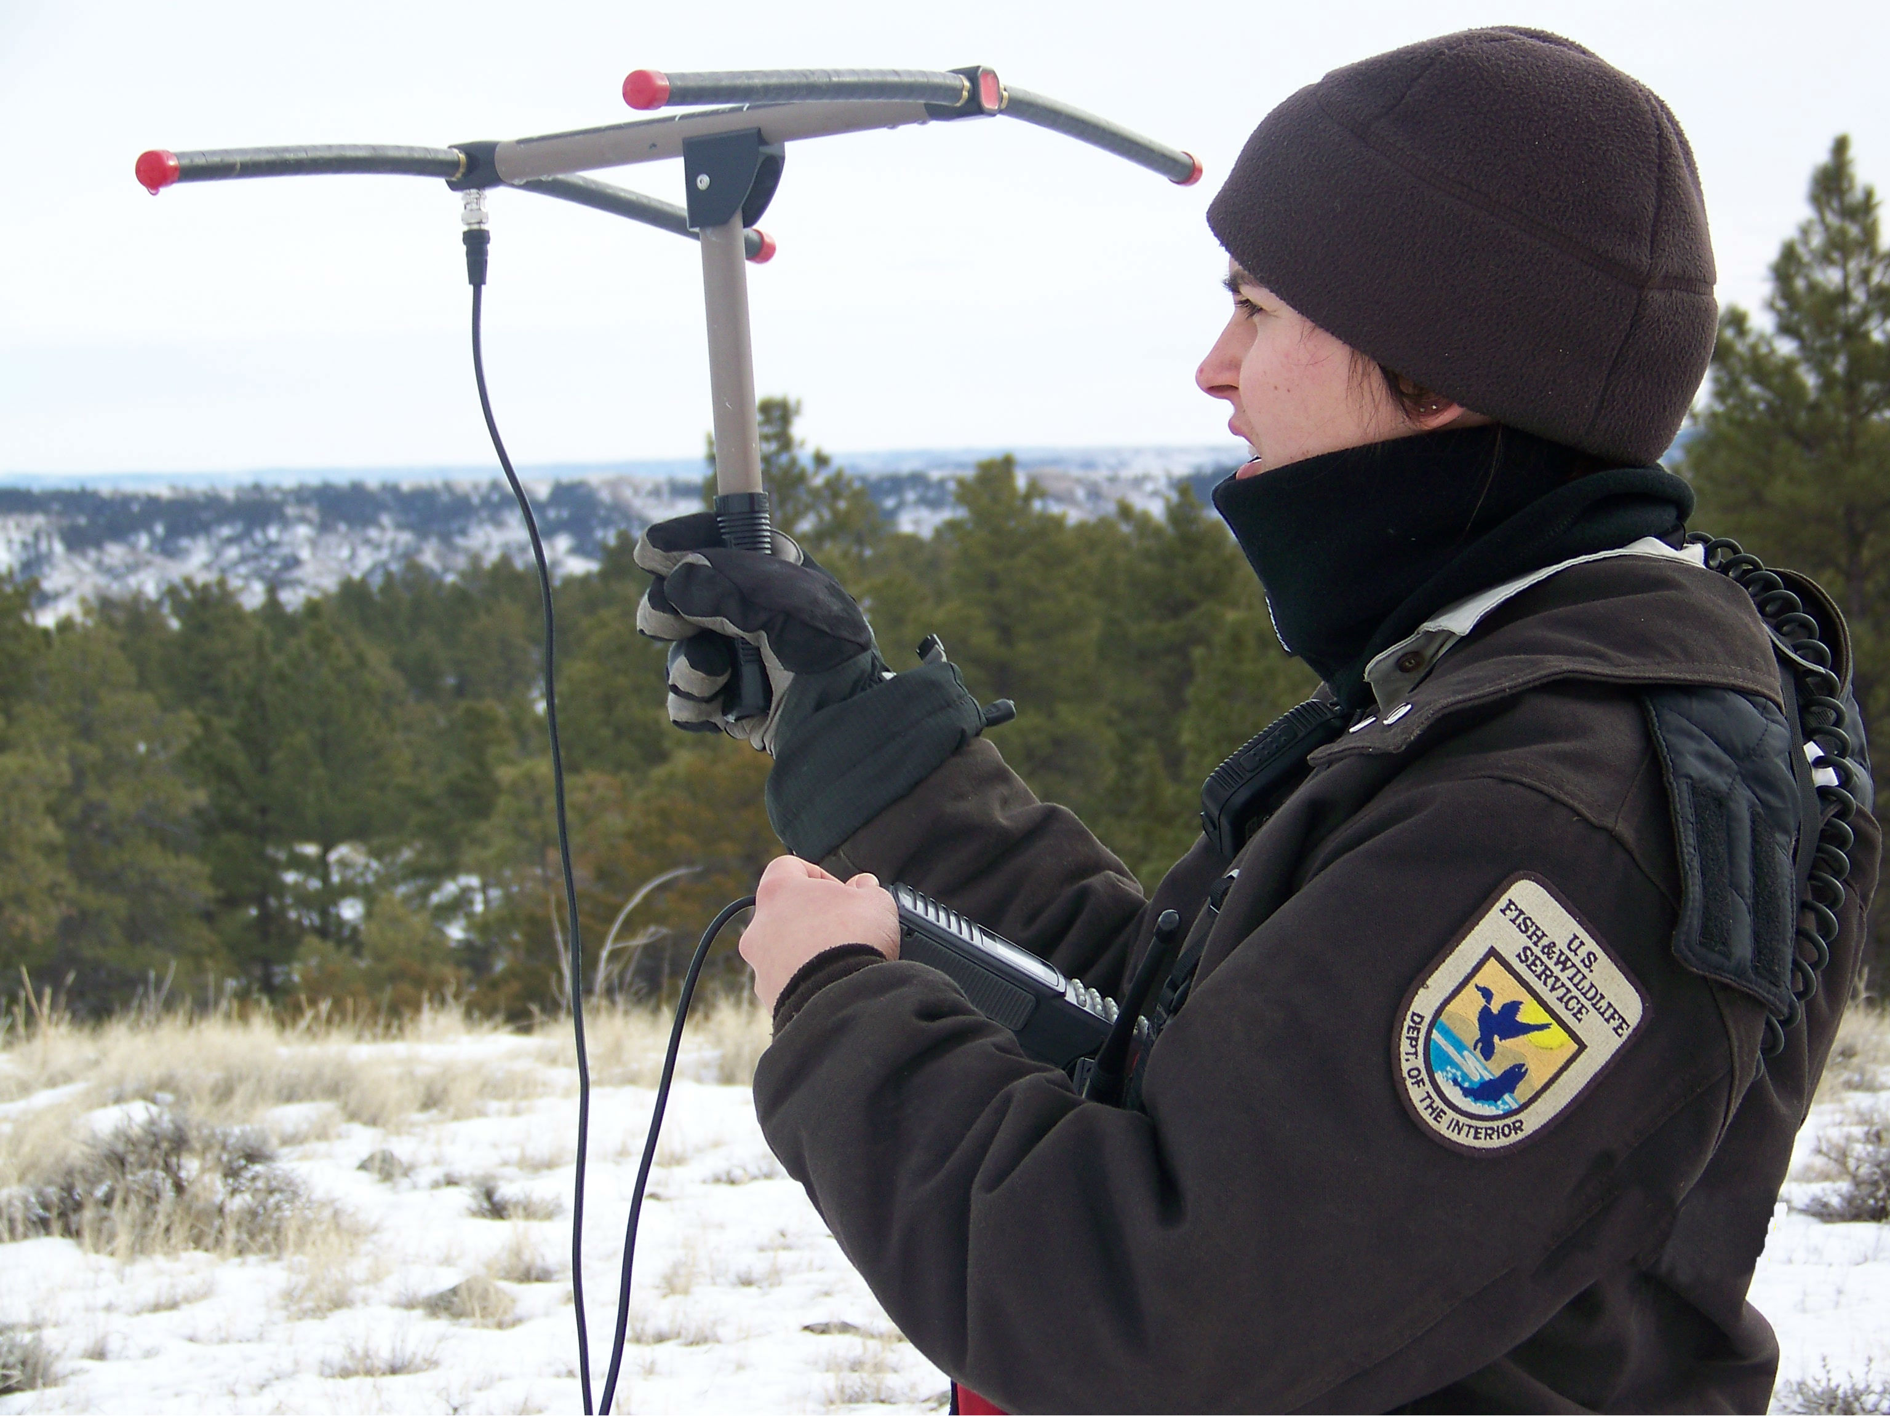

Even More Reasons
Training for:
Locating harmful interference such as
  Jammers
  Stuck transmitters
  Local noise sources
  Interference
Public service
  Search and Rescue
  ELT/EPIRBs
  Wildlife location
  Locating forging invaders to call in air strikes

Slide 7
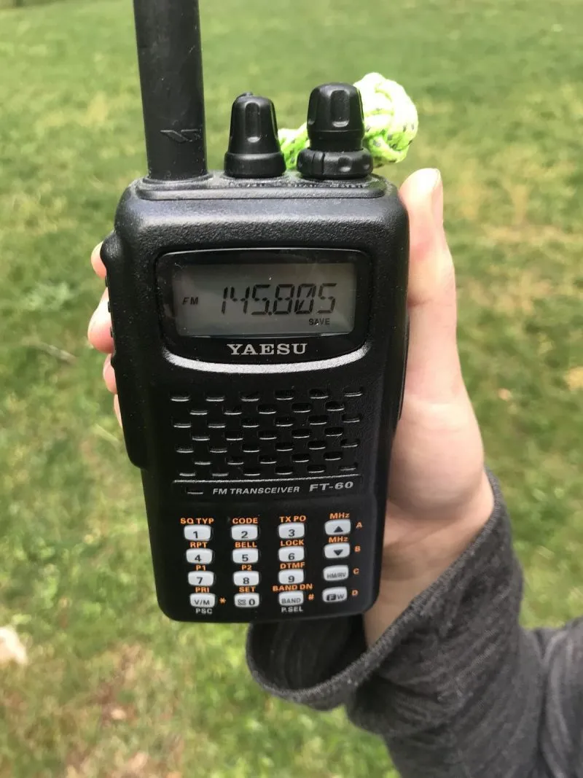
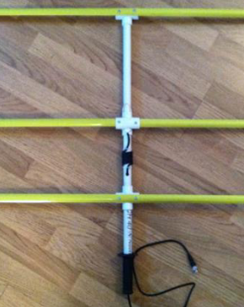
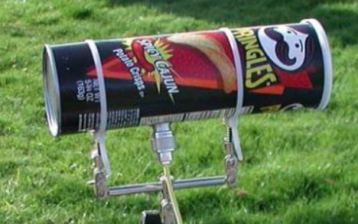
What Do You Need?
A receiver – handhelds work great as do scanners, even a transceiver with a dead transmitter
A map and compass can be useful for triangulation
A directional antenna is extremely helpful but not required
  Home made tape measure Yagi’s
  Commercial Yagi’s
  Loop antennas
  Shielded antennas like a can-tenna
Attenuators can help dial it in

Slide 8

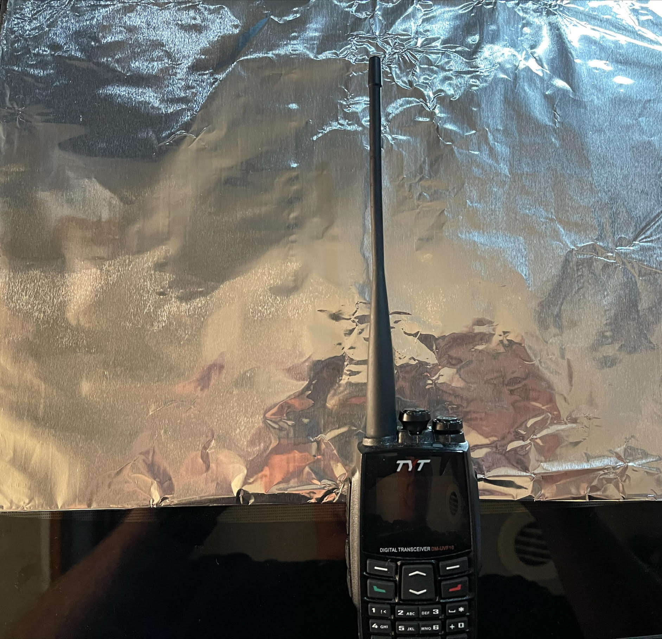
What If I Don’t Have A Directional Antenna?
Body block the signal
  Using the factory-supplied duck antenna on your handheld, hold the radio close to your body and physically turn until the signal is the strongest
  If the signal is strong in all directions, partially unscrew or remove your antenna for more attenuation
Fashioning a shield out of a piece of aluminum foil can also cut the signal strength as you search
Move off frequency 5 – 10 KHz

Slide 9

Listen To A Harmonic (Oh No Math)
As you get close, you will be able to hear the transmitter’s 2nd and 3rd harmonic
If the fox is transmitting on 146.565 MHz, turn your radio to 293.130 MHz or 439.695 MHz and listen for the signal
2nd Harmonic
146.565
+ 146.565
293.130
3rd Harmonic
146.565
146.565
+ 146.565
439.965

Slide 10
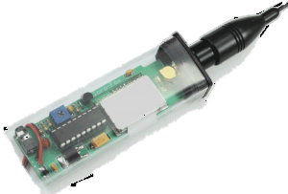
What Is a Fox
The “Fox” is a small transmitter
Low RF power... as low as 5 mW
Can be hidden inside of many items
Operated under the license of the owner
Tell whoever might inadvertently find the fox what it is!
Put your contact information on it, including
  Your Name
  Call Sign
  Phone Number

Slide 11
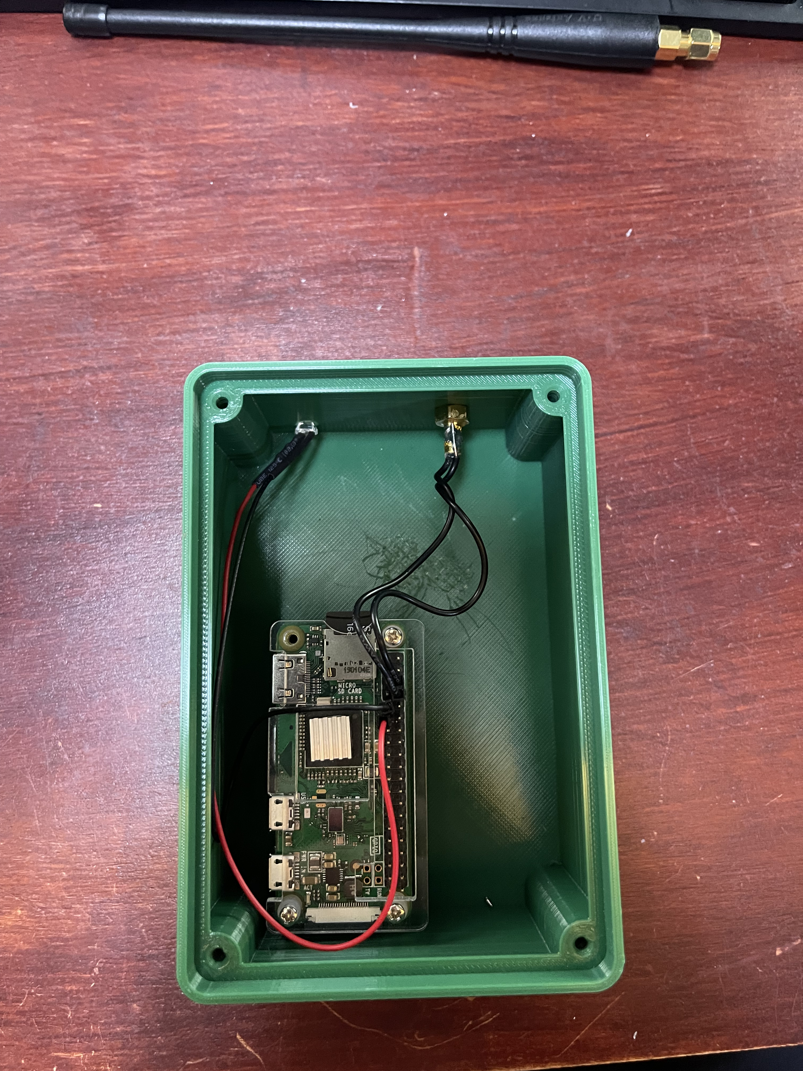
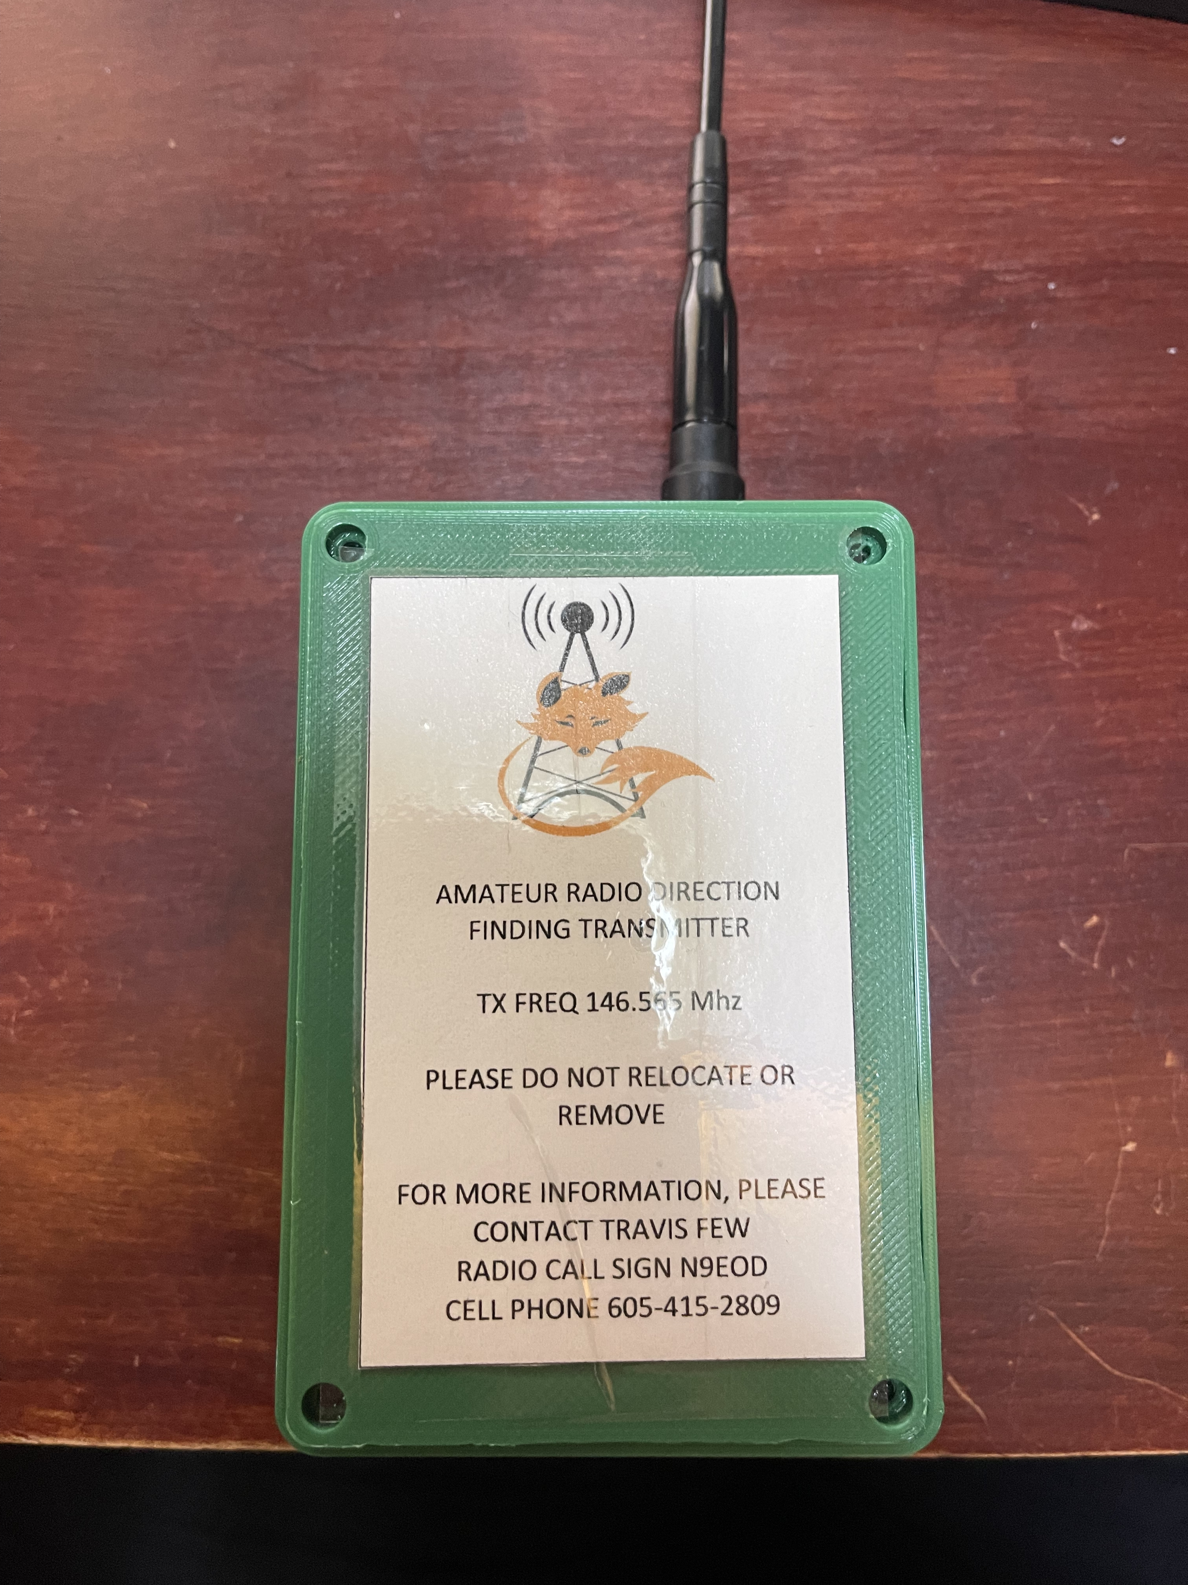
Pi Fox
Raspberry Pi Zero
Pi Sugar Battery
The Pi is the transmitter no other radio needed

Slide 12
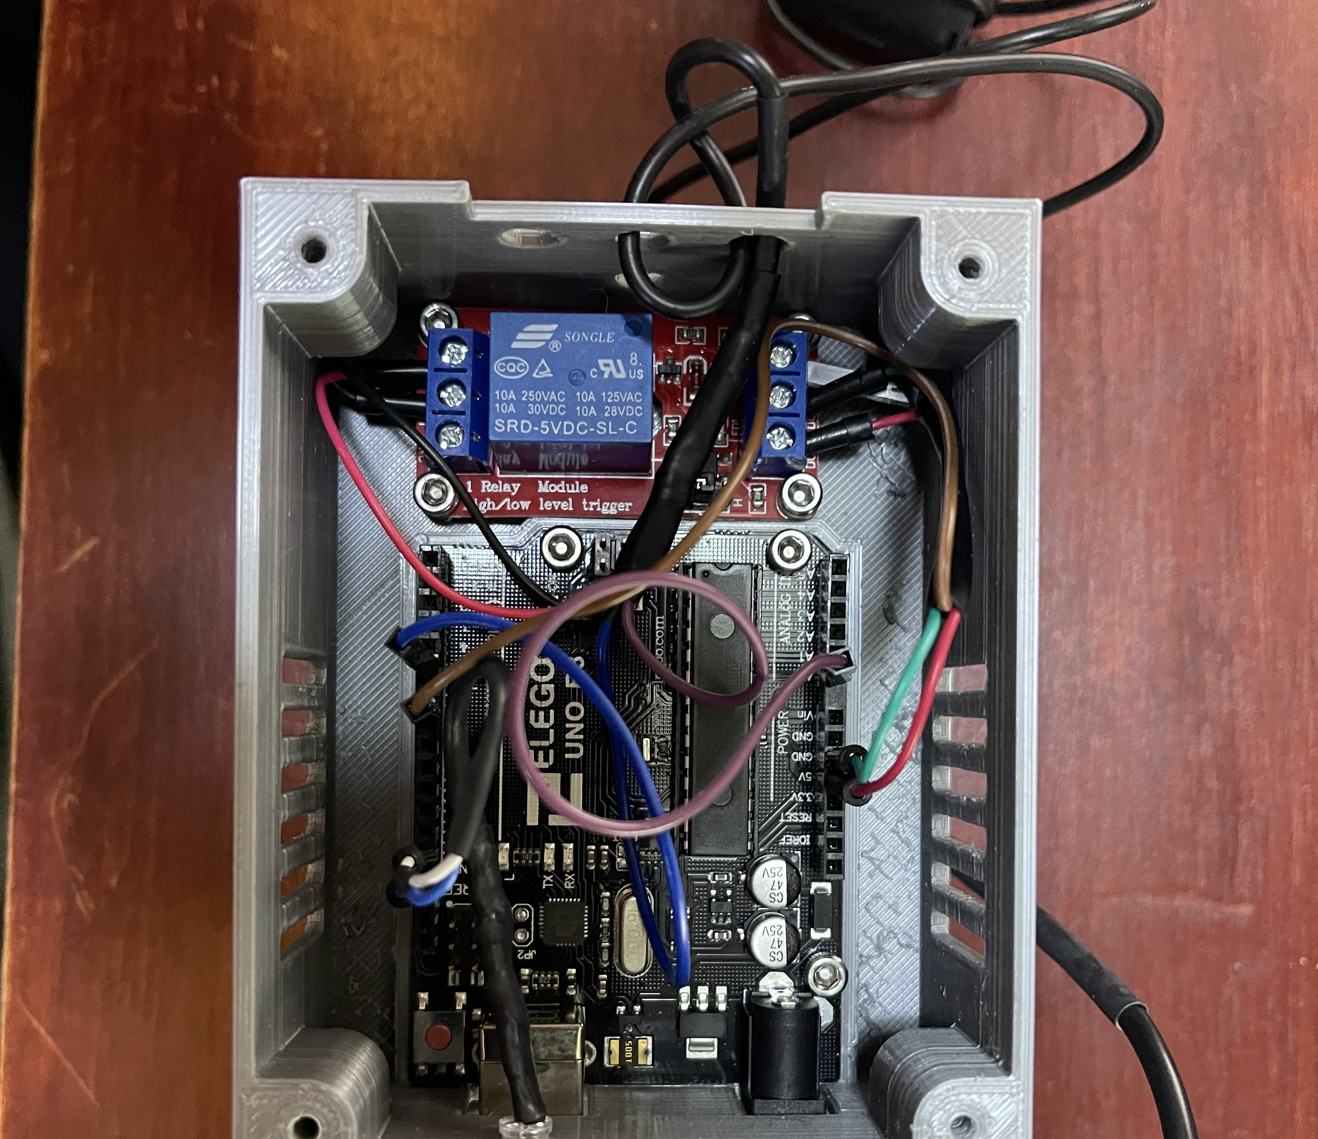
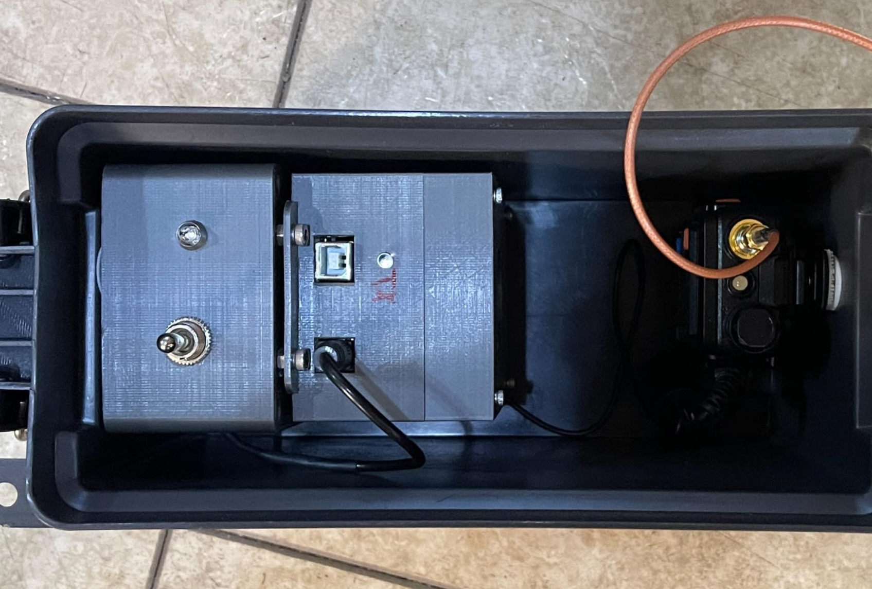
Baofeng uv-5r/Arduino Fox
Arduino UNO
Baofeng uv-5r
Relay

Slide 13

In Today's Age
Notify local authorities of the activities
Leaving an ammo can or other package hidden by a bridge, building, or other structure can set off an unfortunate chain of events
Get Permission if Necessary
  Authorities need to know why people are running around with strange looking antennas and/or snooping around buildings, etc
If someone asks, let them know what we are doing
  Might bring a new person to Ham Radio

Slide 14
2-Meter Tape Measure Yagi Antenna
This antenna is a simple home-brew handheld 2m Yagi that is inexpensive, fun, and easily built
Made with PVC pipe, pieces of steel measuring tape, some hose clamps, a short piece of wire for tuning and some coax with the appropriate connector to fit your radio
The antenna is useful (especially if you want a portable antenna for back packing, etc.) for any radio or satellite use that uses the 2m frequencies
It is more forgiving in brush or forest areas
It is a great project and adds to your collection of ham radio treasures!

Slide 15
References Tape Measure Yagi
Construction process based on designs from the following:
  https://www.jpole-antenna.com/2017/02/07/build-it-2-meter-tape-measure-yagi-beam-antenna/
  http://nt1k.com/blog/2012/vhf-3el-tape-measure-yagi/
  http://theleggios.net/wb2hol/projects/rdf/tape_bm.htm
Attenuator
  https://kc9on.com/product/fox-hunt-offset-attenuator/

Slide 16
References Foxes
Pi Zero Fox
  https://github.com/km4efp/pifox
Baofeng Fox
  https://wcar.ca/pg/fox-tx/
  Radio: https://www.amazon.com/Baofeng-UV-5R-136-174-400-480Mhz-1800mAh/dp/B074XPB313/ref=sr_1_3?keywords=uv-5r&qid=1646000604&sr=8-3
  Arduino: https://www.amazon.com/gp/product/B01EWOE0UU/ref=ppx_yo_dt_b_asin_title_o01_s00?ie=UTF8&psc=1
  Relay Module: https://www.amazon.com/gp/product/B00LW15A4W/ref=ppx_yo_dt_b_asin_title_o01_s00?ie=UTF8&psc=1
  Antenna Cable: https://www.amazon.com/gp/product/B086JH3NKM/ref=ppx_yo_dt_b_asin_title_o01_s01?ie=UTF8&psc=1
Pre-built Foxes
  https://www.byonics.com/mf

Slide 17
References Other resources:
http://www.homingin.com
http://www3.sympatico.ca/alduncan/ham/RDFing.pdf
https://www.arrl.org/files/file/ETP/Fox%20Hunting%20article%204_21.pdf
Mapping
  www.SARTopo.com
  First responder discount: https://sartopo.com/join/accountrequest/first-responder

Slide 18
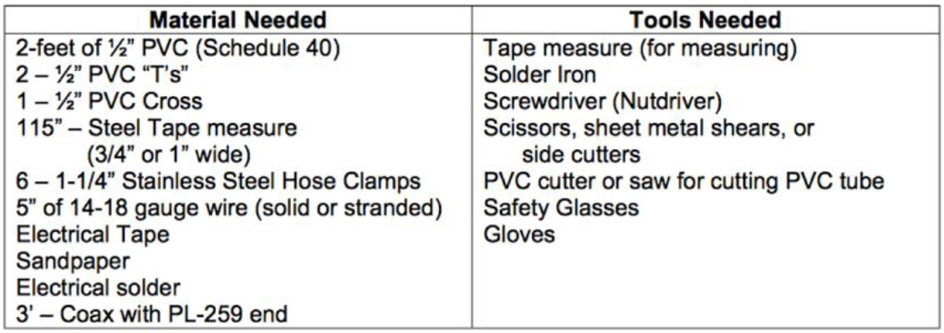
Tape Measure Yagi Supplies

Slide 19
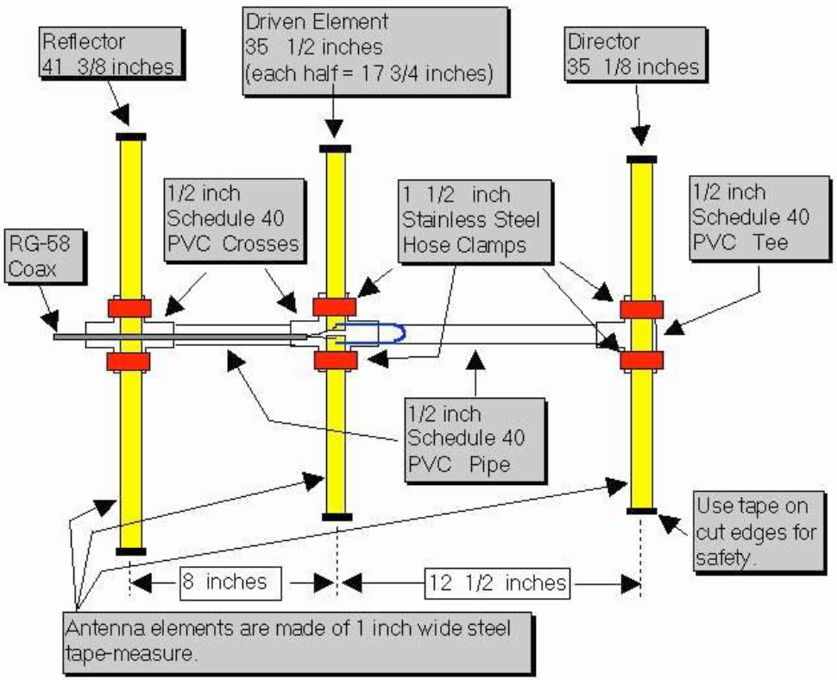
Diagram

Slide 20
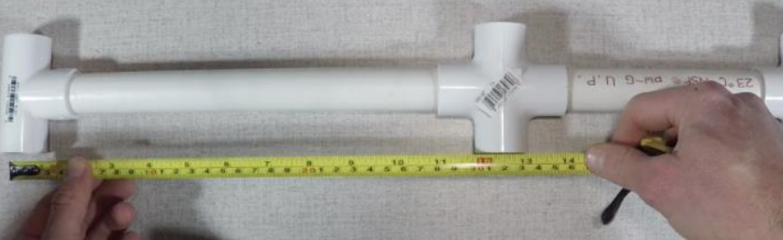
Procedure
Step 1 Cut three pieces of PVC tubing. One piece will be 11 1/4 inches long and the second will be 6 7/8 inches long. These pieces will make up the support boom for the antenna. The third piece can be any length, it will be the handle for the antenna, so give yourself about a foot or foot and a half. Whatever is comfortable
Fit the pieces of PVC tube together with the crosses and the T. You may PVC cement if you wish to make the connections permanent, otherwise dry fitting them will be fine. The distance between the first cross and the middle cross has to be 8 inches and the distance between the middle cross and and the T has to be 12 1/2 inches. These are measured from the center points of the connectors. Make adjustment if necessary.

Slide 21
Procedure
Step 2 Cut the tape measure into four pieces. One piece will be 41 3/8 inch and the second will be 35 1/8 inch. These are the reflector and director elements for your yagi. The driven element is made up of two pieces, so cut two pieces that are 17 3/4 inches long.
Step 3 On the two driven element pieces, sand or grind away the paint from one corner. This is where we will solder the the coax and the hairpin match. Apply flux and use your soldering iron to tin this area. It’s easier to tin this area now before attaching the elements to the support boom.
Step 4 Assemble the director and reflector elements. Making sure they are centered, use the hose clamps to attach the elements to the T and Cross connectors.

Slide 22
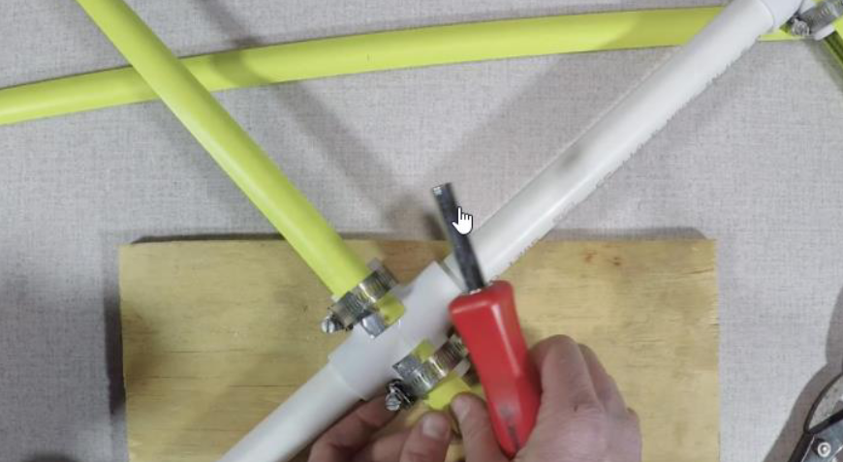
Procedure
Step 5 Assemble the driven elements. Using the hose clamps, attach each half of the driven elements to the Cross connector. There should be a one inch gap between the two pieces.

Slide 23
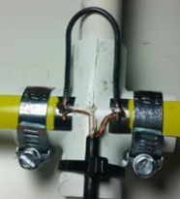
Procedure
Step 6 Attach the hairpin match. Take your 5 inch piece of wire and strip 1/4 inch off each end. Bend the wire so it is in a U shape with a 3/4 inch gap. Solder this to the tinned ends of the driven element.
Step 7 Attach the coax. I’ve got a six foot length prepared piece of RG-58 coax where I put a BNC connector on one end and stripped the braid and center conductor on the other. You’ll solder these two ends to the driven element of the antenna. It doesn’t make a difference which end goes where. Now before you solder, you can drill a hole in your boom and thread the coax inside the pipe. Otherwise just use a couple of cable ties or electrical tape to secure the coax to the antenna.
With that, your antenna is complete. With these dimensions the antenna should be resonant at about 146.5 Mhz. If you are going to use this as a receive antenna for fox hunting, tuning isn’t critical, but if you plan to transmit with it, then you can check it with an antenna analyzer or power meter and make any small adjustments by varying the gap between two parts of the driven element.

Slide 24
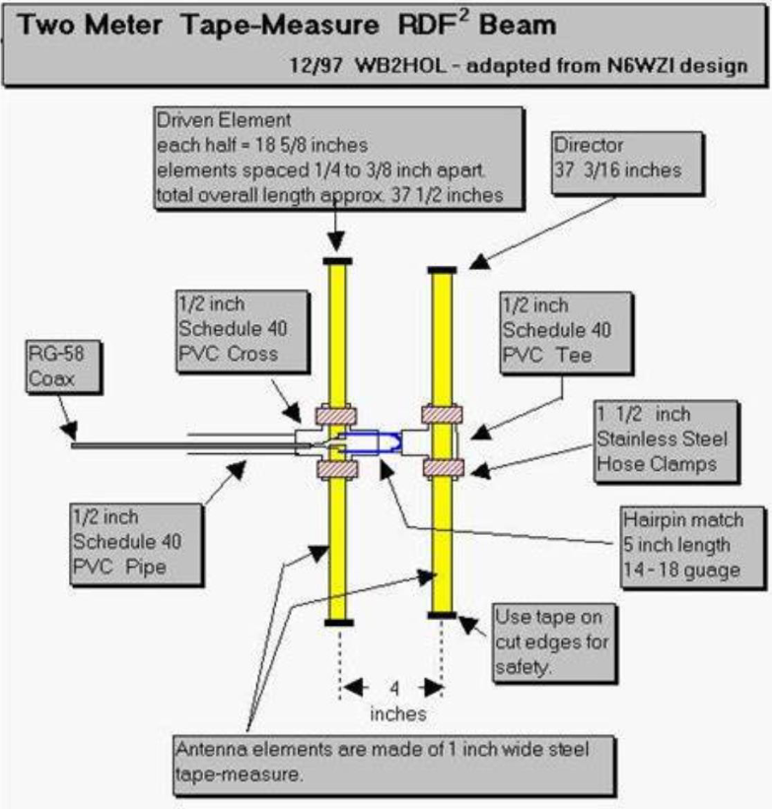
Other Variant
A 2 element Yagi will have less gain as it does not have a reflector like the 3 element Yagi

